Slide 1
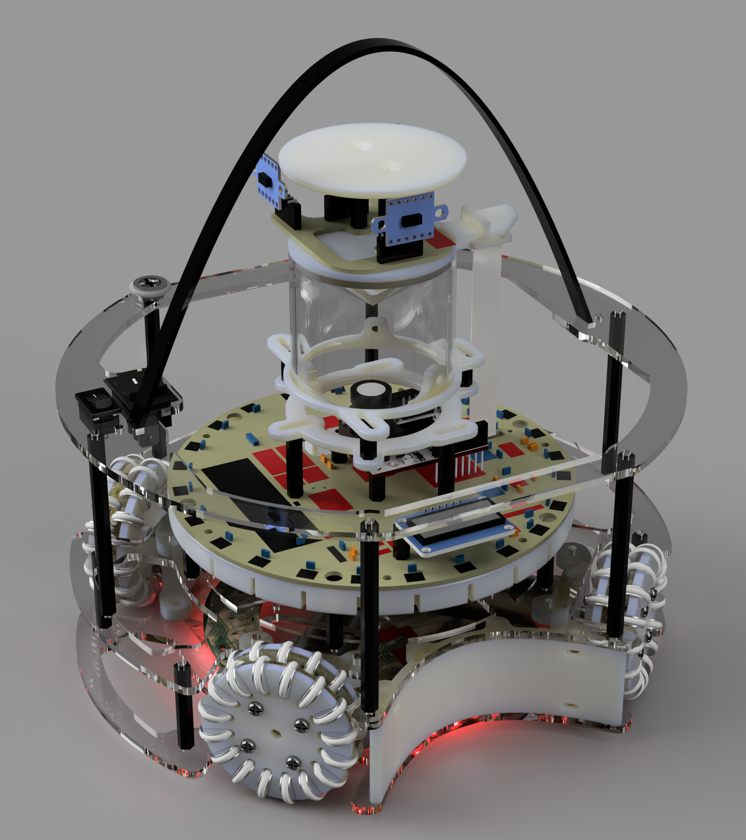
M&A - BBC

Slide 2

Team Structure
Aparaj Bogahawatta:
Primary Software Developer
Primary Robot Strategy Developer
Tertiary Hardware Developer
Matthew Feros:
Primary Hardware Developer
Primary Electronics Developer
Secondary Robot Strategy Developer
Gus Gannon:
Secondary Hardware Developer
Secondary Electronics Developer
Secondary Documentation Developer
Taewhan Kim:
Tertiary Hardware Developer
Tertiary Electronics Developer
Primary Documentation Developer

Slide 3
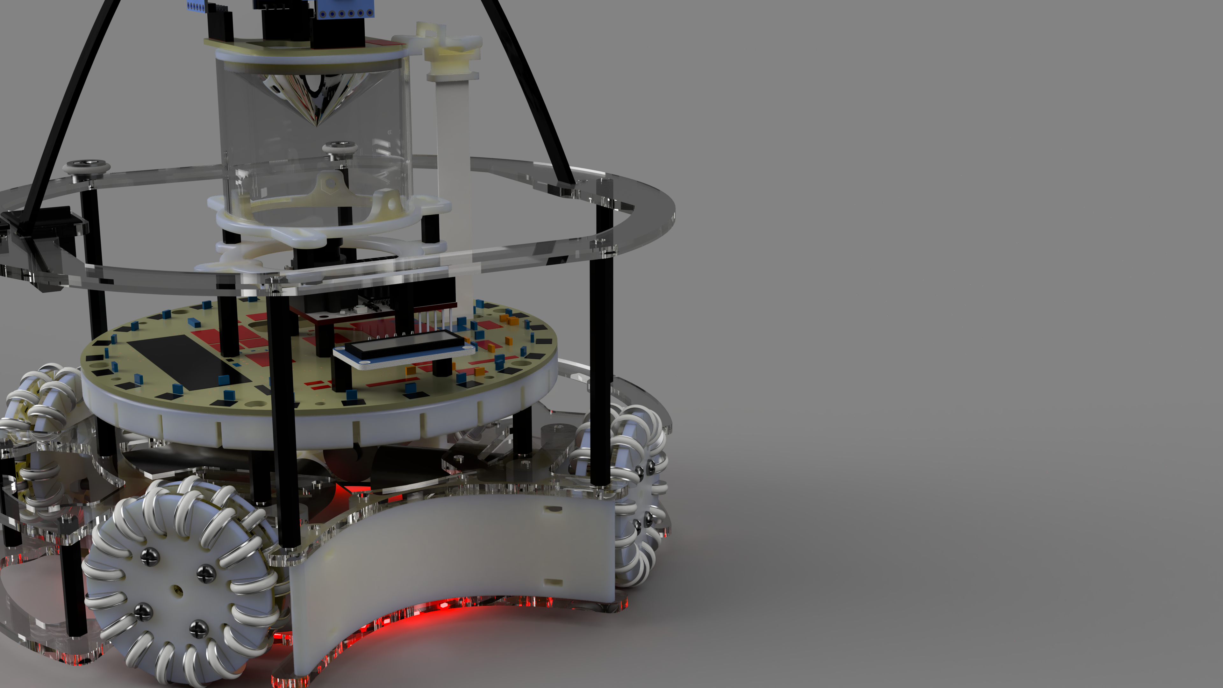
Chassis Design

Slide 4

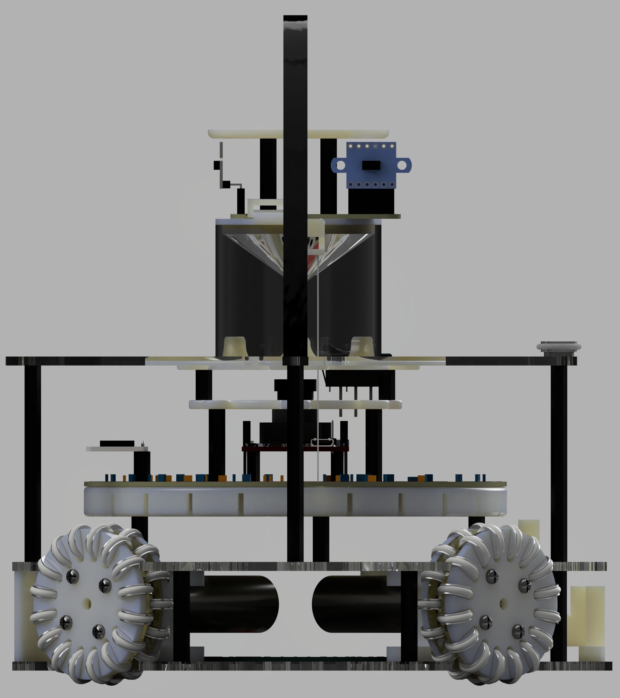
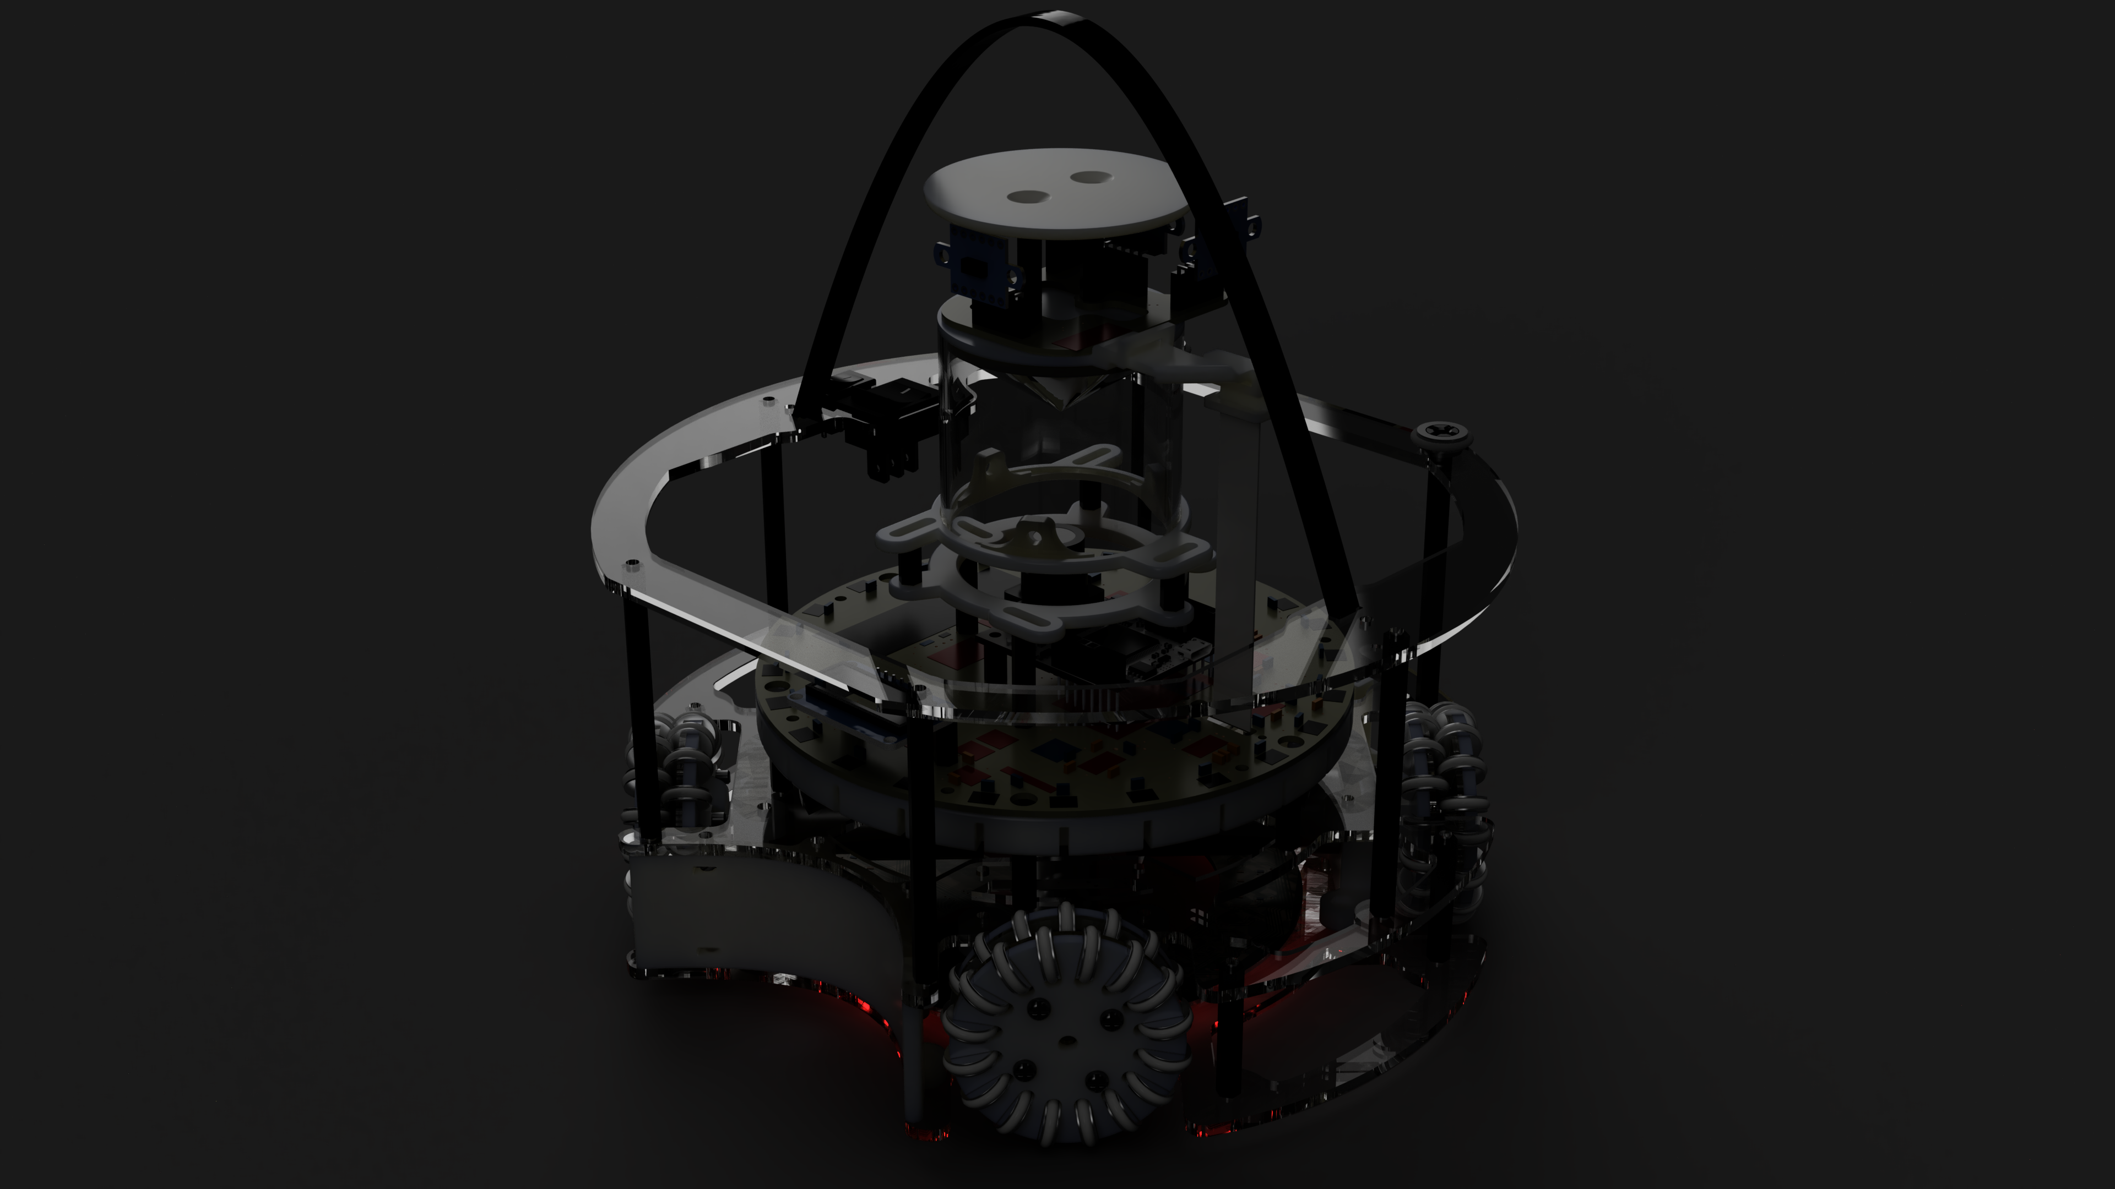
Multilayer Design
Main Circuit Board:
-Microcontrollers
-Screen
-IMU
-Camera
-Motor Controllers
-Power Supply
Middle Layer:
-Motor brackets
-TSSP sensor bracket
-Top plate supports
Bottom Layer:
-Light sensors
-Motor brackets
-Battery holder

Slide 5

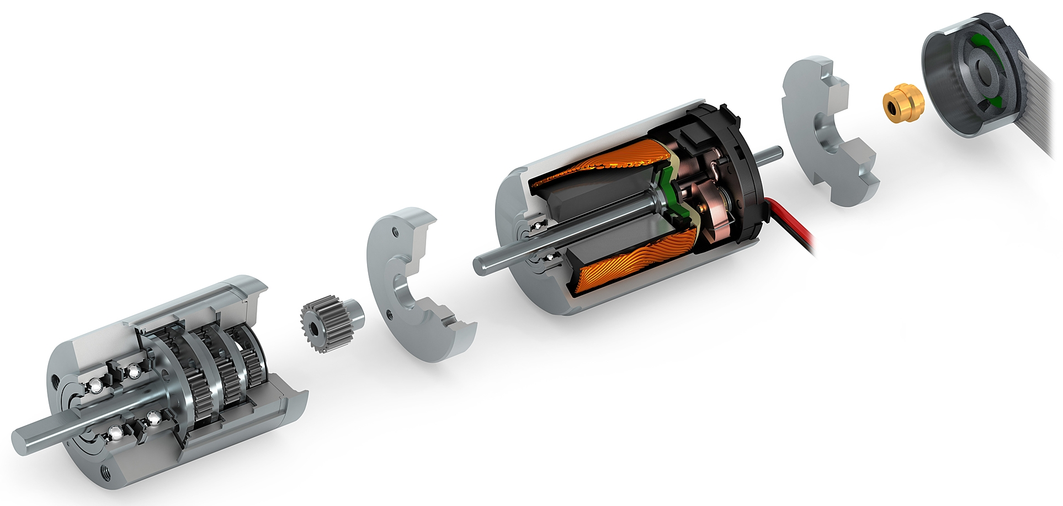
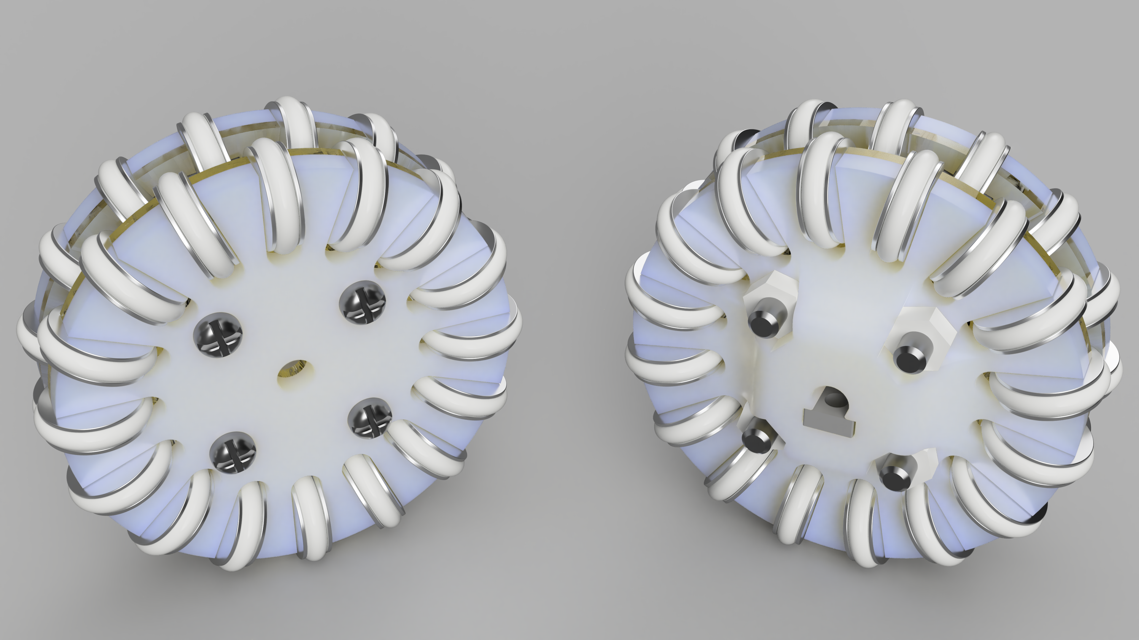
Drive System
9v Maxon DCX 19, 16:1 gear ratio
Omnidirectional Wheel
Custom Design
Double Layer
4 Motors Separated by 90°
Support Brackets Give Motors More Stability

Slide 6

Structural Stability

Slide 7

Ease of Use
Magnetically attached sliding battery door
Accessibility of screws and embedded nuts
Easily replaceable components on circuit boards
Quick disconnect connections between circuit boards

Slide 8

Reliability
PCB’s Reduce Wire Runs and Risk of Disconnection
Minimum Amount of Parts Used
Reduces Maintenance Time
Reduced Human Error in Construction
Simple Microcontroller Layout
Reduces Reliability on Communication Between Controllers
Battery Voltage Meter displays a warning to prevent over discharge

Slide 9
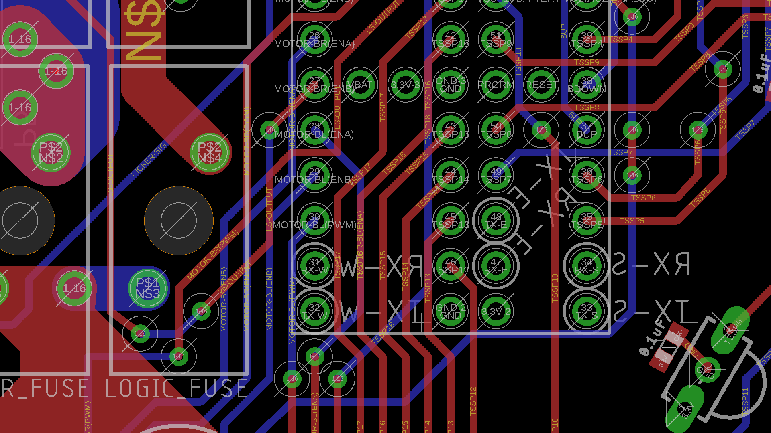
Use of Sensors and Electronics

Slide 10

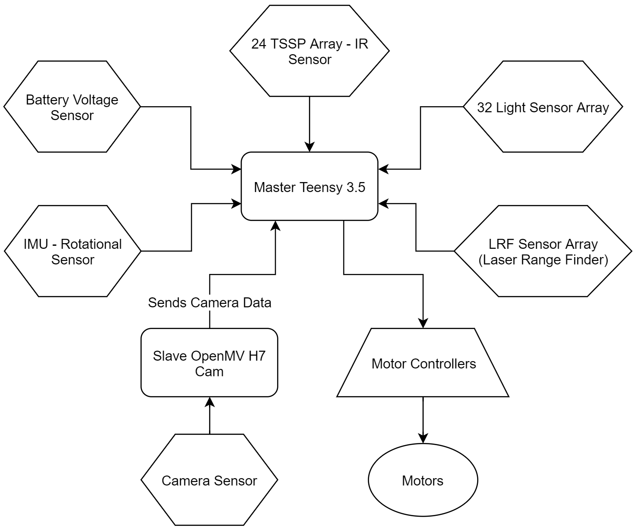
Sensor Layout

Slide 11

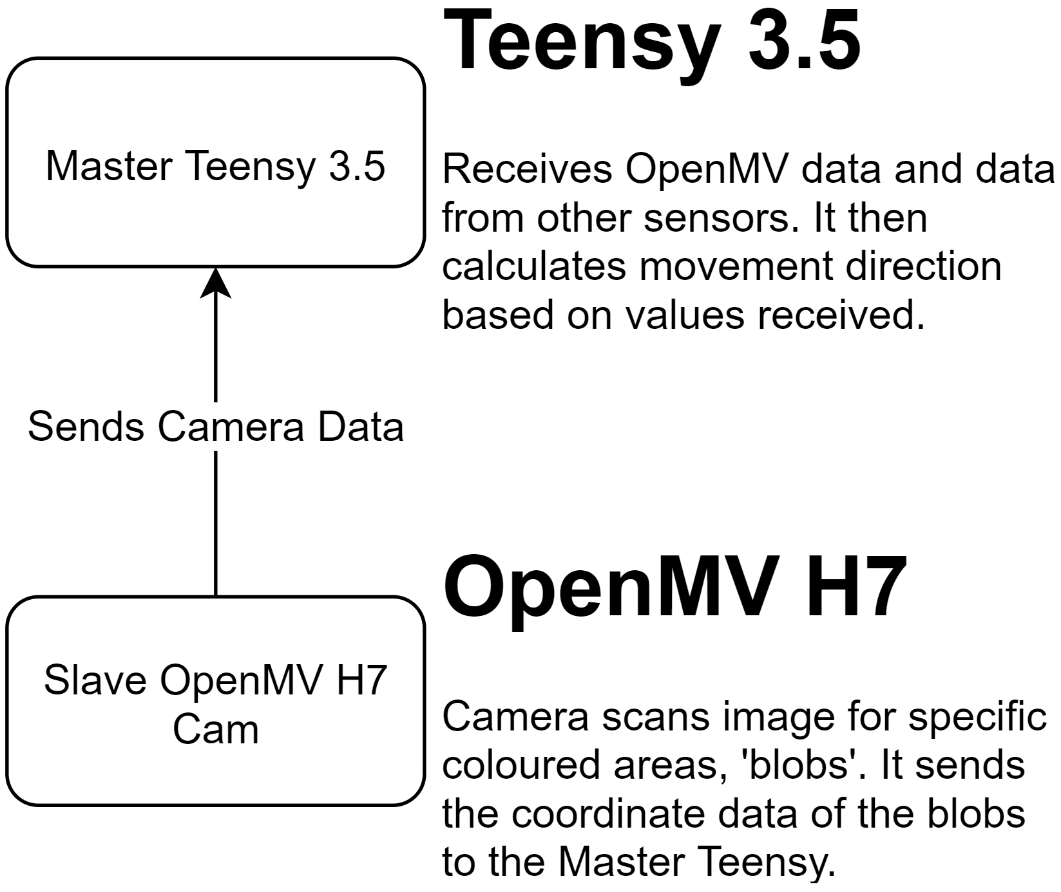
Microcontrollers

Slide 12

Motor Control

Slide 13

Computer Vision

Slide 14

High Density Light Sensors

Slide 15

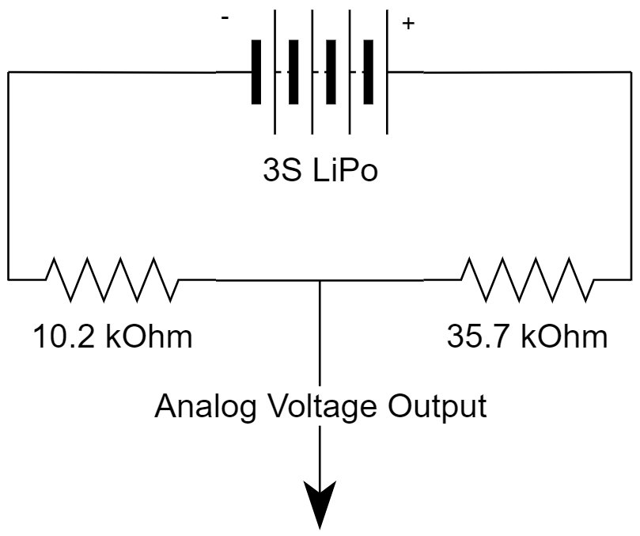
Battery Voltage Metrics
Battery voltage goes through a divider
The ratio of the divider is determined by the resistor values
Supplies Teensy 3.5 with an analog input in the range of 0 - 3.3V
This allows the robot to warn us when the battery is low
Reduces the risk of draining the battery past its charge point
Increases the longevity of the batteries

Slide 16
Game Strategy

Slide 17

Inter Robot Communication

Slide 18

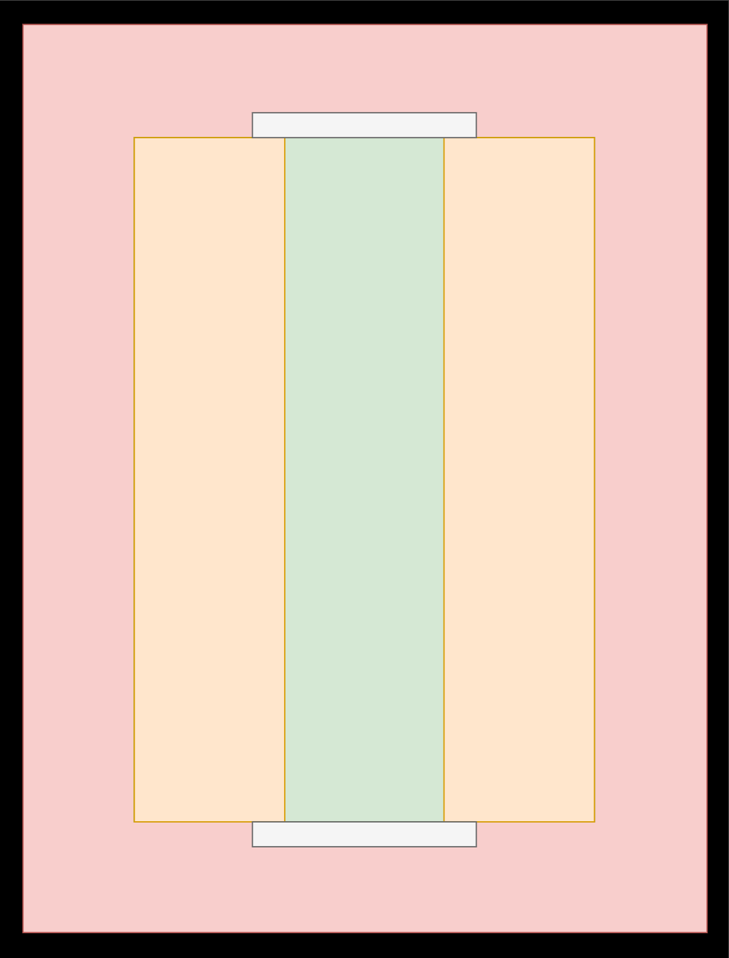
Co-ordinate System
LRF’s provide the robot with its distance relative to the wall
The robot uses this to slow down when it is near the wall
This pre-emptively slows the robot down before reaching the line
This causes the rate of the robot going out to be much lower

Slide 19

Goal Tracking and Orientation

Slide 20

On Board Interface

Slide 21

Live Debugging

